Slide 1
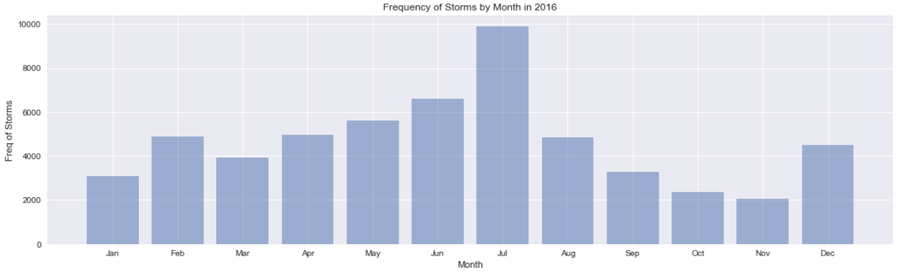
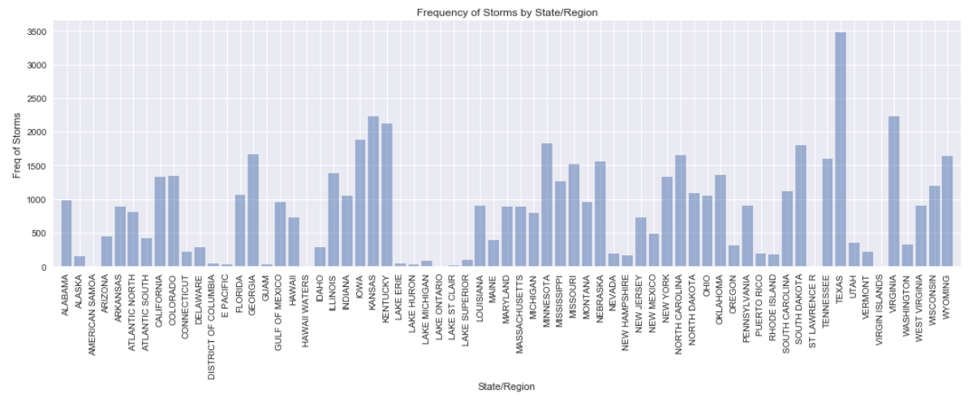
Determining which Categorical/Ordinal Variables to One-Hot Encode
Our original dataset came with 42 decision variables,: 6 date/time variables,

Slide 2
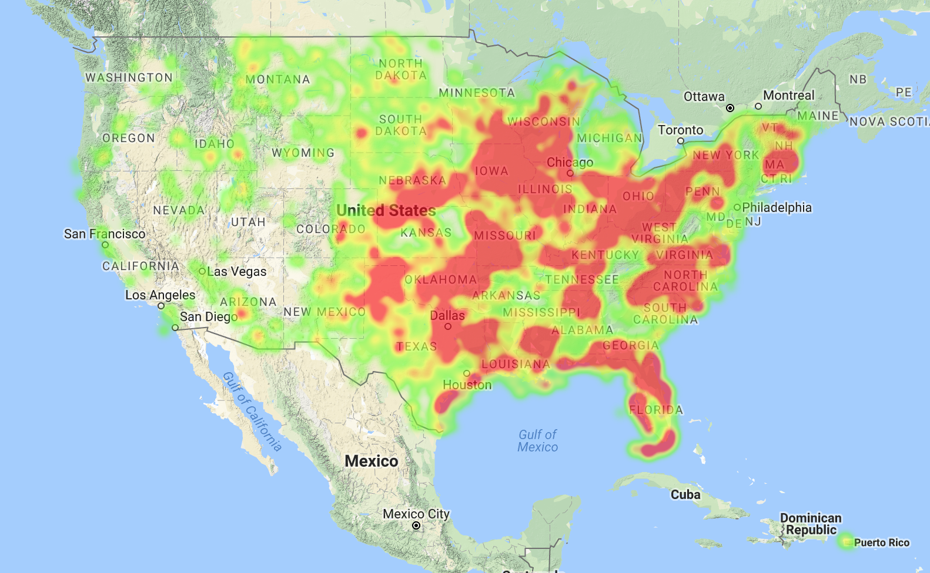
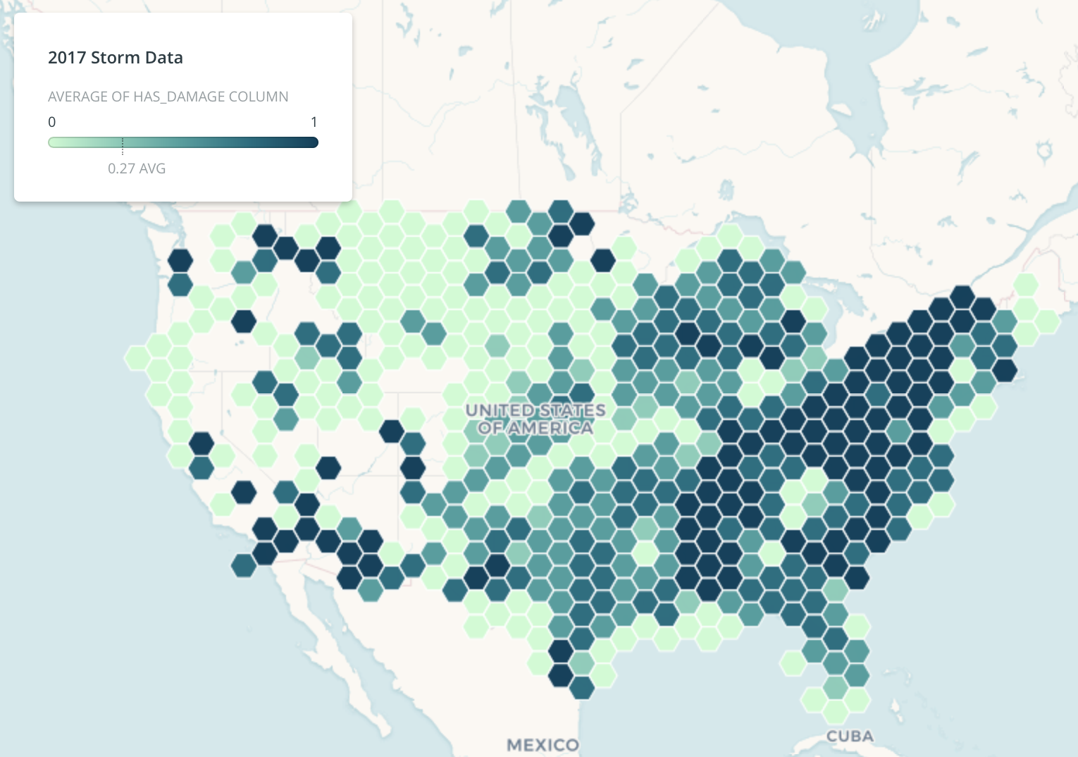
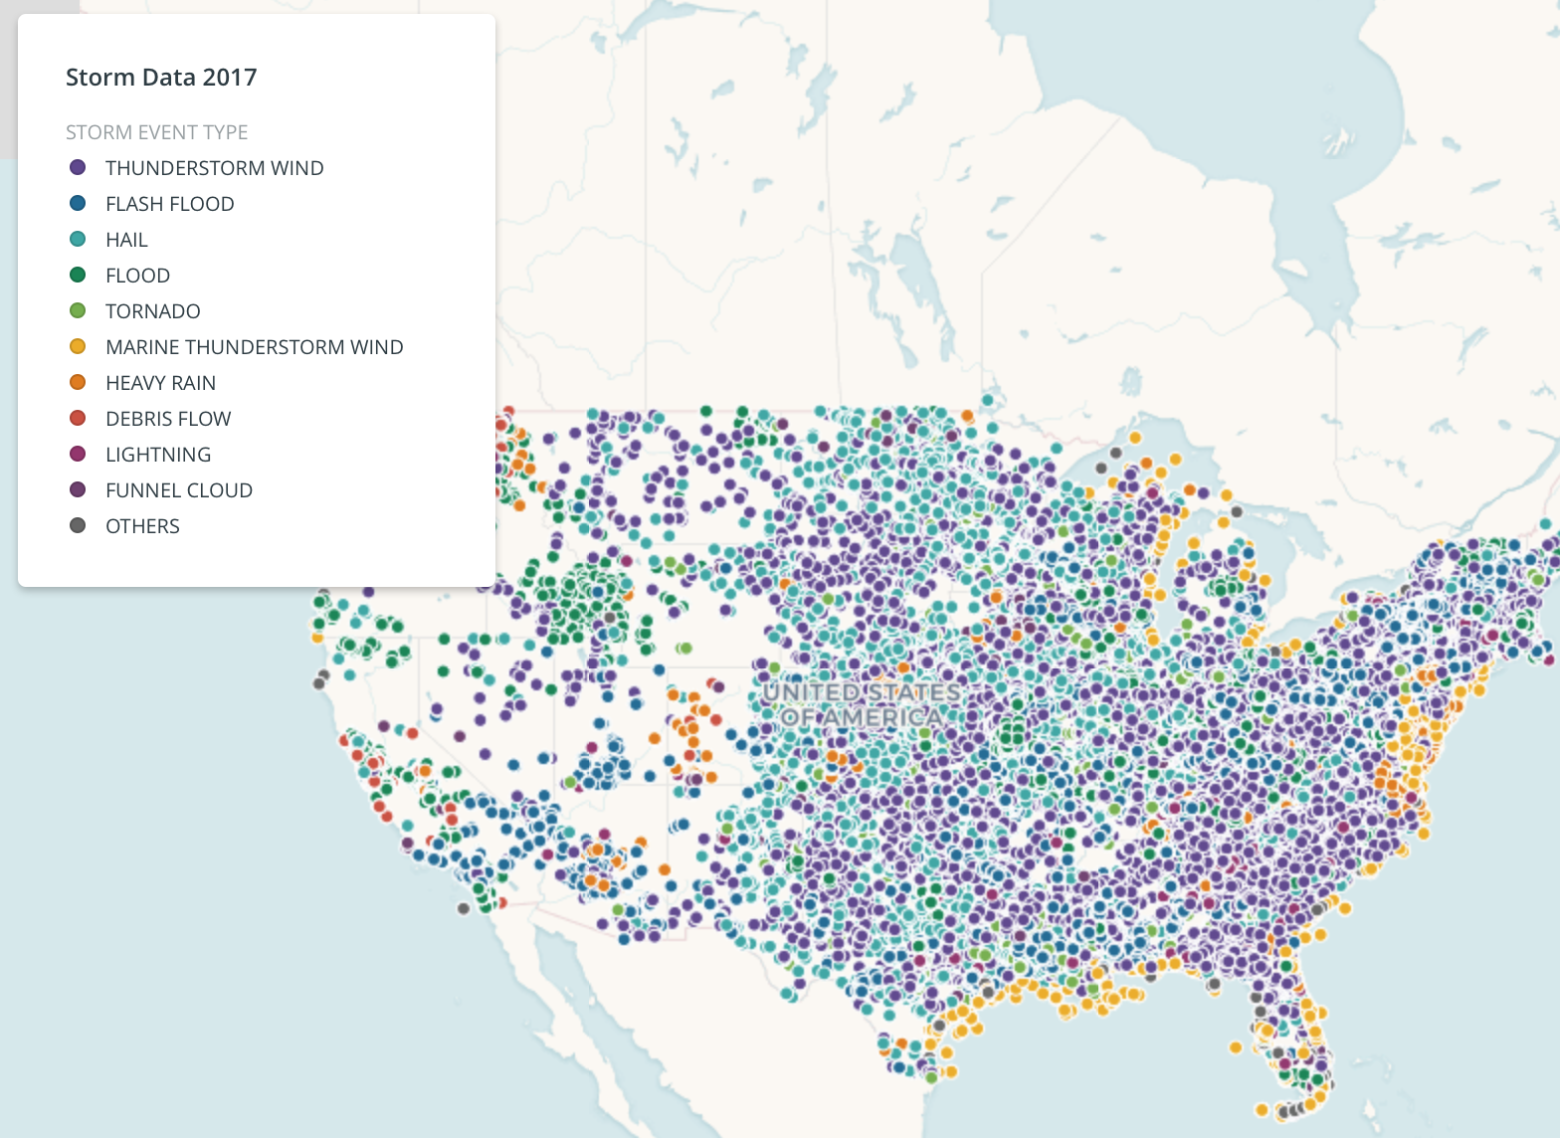
Map EDA
One step of our EDA was to visualize our data on maps. Using both the Carto mapping service and a self-written Google Maps heatmap webapp, we generated some images to see how our data looks across the US. These images help us understand how our storm data trends spatially, and the baseline distribution of data across the nation. Additionally, these graphs are important for our final analysis and presentation of our project because we need systems in place to visual data on maps. We will certainly incorporate these kind of visuals in the final presentation of our analysis and predictions.
Figure 6: This is a GMaps heatmap showing distribution of all storm data across the US. It is important to see that our storms are concentrated East of the Rockies (perhaps simply due to reporting). Additionally, there is a concentration of storms along the Gulf of Mexico, and in Tornado Alley.
Figure 7: This Carto images shows likelihood of a storm causing monetary damage. Dark squares means that most storms cause some damage. We see clear regional trends in where damage is caused like in the Ohio River Valley and along the SW southern border. Clearly, damage has spatial trends, which makes the other graphs here clearly relevant to our predictive power.
Figure 8: Shows storm types in our dataset. The legend lists storm freq., and we see trends like Marine Thunderstorms all along the Atlantic Coast and debris flow (mudslides) on the Pacific Coast. Hail, Thunderstorms, and Floods are widespread, but certainly show some clustering and regional differences.

Slide 3
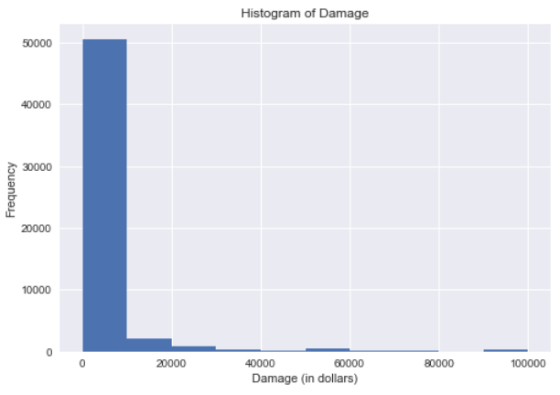
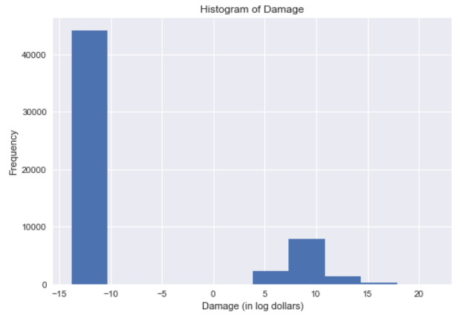
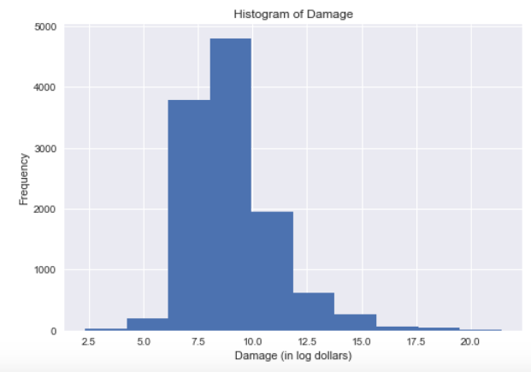
Other work done so far:
Normalization of Damage in Log Dollars:
Latitudes and longitudes were translated into zip codes using the
R package “Zipcode”, which assigns an approximate zip code to
a latitude - longitude based on the zip code of the nearest latitude –
longitude. Although this method is imperfect, the approximation is
justifiable given the prior approximations of just two locations for
these weather events, i.e., the weather event latitudes and longitudes
are approximate as well.
Upon finding zip codes, data were scraped from the 2010 US Census Via the American Fact Finder. Around 300 pieces of information for each zip code were retrieved, including information about count and percentages of residents by age and gender cohort, race-ethnicity, family status, and housing status. These data, combined with information about income, will be important controls in the models run.
Additionally, we have made a preliminary classification model to classify storms as Damage Causing or Not (similar to Delay or Not) using our original dataset and one-hot encoded categorical predictors. The approximate train/test accuracy of this preliminary model is ~0.81, so we will work to improve this accuracy as we bring in more data. This baseline also confirms our belief in the predictive power of our dataset. Additionally, we will begin to build a regression model to predict the monetary damage of a storm given that it causes damage.
In these steps, we need a more rigorous approach to dropping null values, which will likely include imputation, and we will need to spend time formally selecting the best predictors (past just EDA analysis to see what might be predictive). However, we feel like the steps taken so far have confirmed that our data works well, and a successful model will be possible!
Figure 9: This progression shows our effort to standardize our response variable, total damage. Since we can standardize to a near normal distribution, this means we have the power to use methods like Multiple Regression, which requires near-normal response variable
Updated Project Statement:
Now that we have done our EDA and spent a significant amount of time getting to know this dataset, we feel confident in our ability to predict storm damage with our data, and the additional Census data that we have brought in. Our project goal remains consistent: to predict damage of US storms to improve relief efforts.
The first step in this process will be to classify storms as damage causing or not. With just our original storm dataset and a rough baseline model, accuracy is 0.81, and we will improve this with better classifier methods, and additional data.
The next step in this model will be to take the subset of data that is classified to cause damage, and regress to predict the monetary damage that these storms cause. For this step, we will standardize our response variable (“DAMAGE_TOTAL” which is the sum of property and crop damage) between 0 and 1. This step will be more challenging, and will likely not yield and extremely high R² value, but like the midterm delay problem, we will attempt to use many methods from this course to maximize the predictive power of our data to improve the prediction, so that our model has real-world powerful implications.

